Slide 1
RX Intermodulation Test

Slide 2
Noise Figure Test
ADC_NBits = 14;
LNA_NoiseFigure = 0;
RxPhaseNoise = [100, -97.133, 1000, -106.072, 1e4, 118.607];
RxGainImbalance = 0.002;
RxI_OrgOffset = 0.0006;
ADC_NBits = 14;
LNA_NoiseFigure = 5;
RxPhaseNoise = [100, -97.133, 1000, -106.072, 1e4, 118.607];
RxGainImbalance = 0.002;
RxI_OrgOffset = 0.0006;

Slide 3
Noise Figure Test
ADC_NBits = 14;
LNA_NoiseFigure = 10;
RxPhaseNoise = [100, -97.133, 1000, -106.072, 1e4, 118.607];
RxGainImbalance = 0.002;
RxI_OrgOffset = 0.0006;
ADC_NBits = 14;
LNA_NoiseFigure = 13;
RxPhaseNoise = [100, -97.133, 1000, -106.072, 1e4, 118.607];
RxGainImbalance = 0.002;
RxI_OrgOffset = 0.0006;

Slide 4
Noise Figure Test
Noise Figure | VXT_EVM | Sim_EVM | Delta | VXT_Throughput | Sim_Throghput
0 | -8.379 | -8.383 | 0.004 | 100 | 100
5 | -3.32 | -3.551 | 0.231 | 100 | 100
10 | 1.853 | 1.816 | 0.037 | 100 | 100
13 | 6.401 | 6.254 | 0.147 | 15 | 30

Slide 5
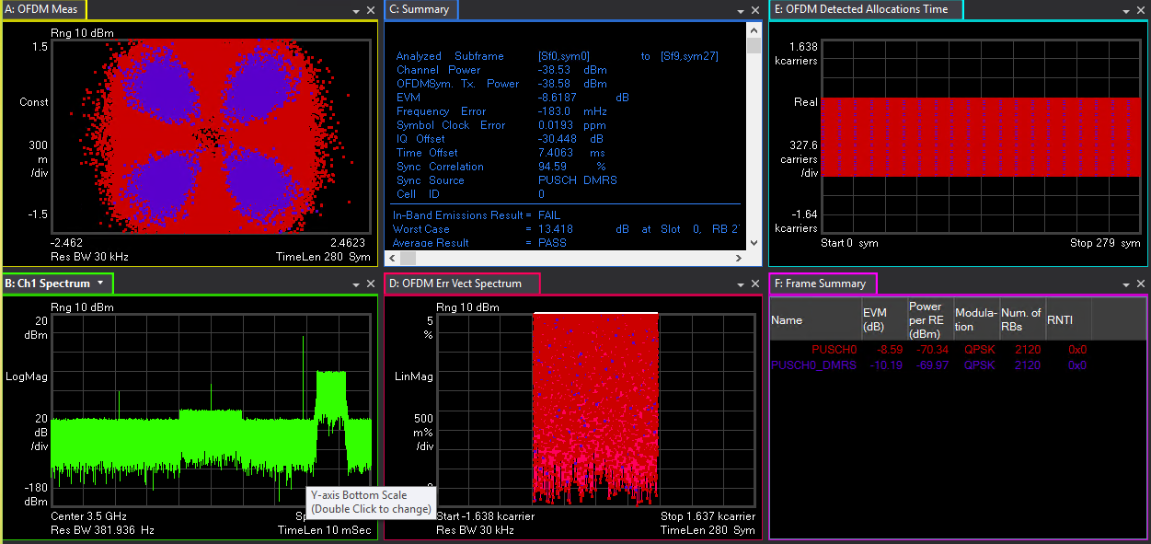
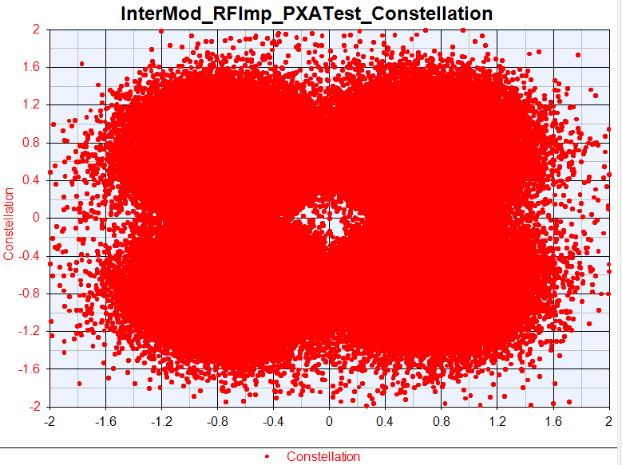
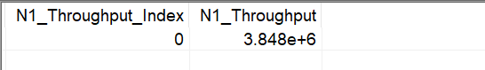
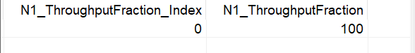
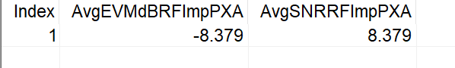
VXT Noise Figure=0

Slide 6
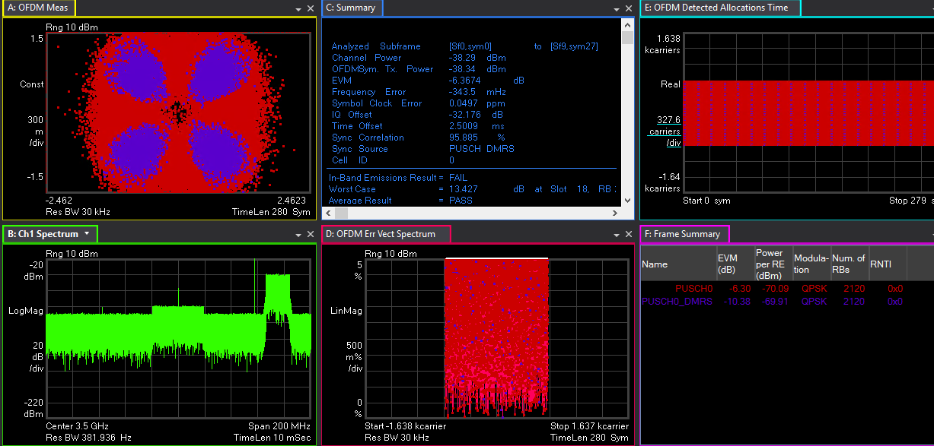
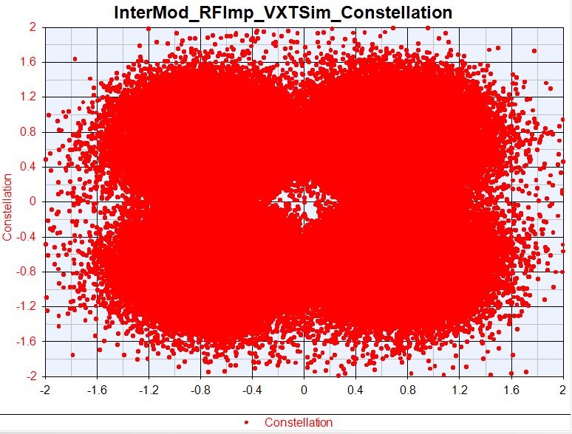
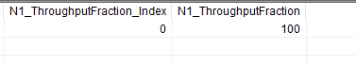
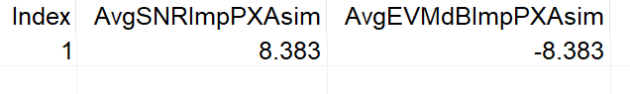
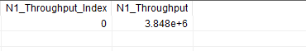
Sim Noise Figure=0

Slide 7
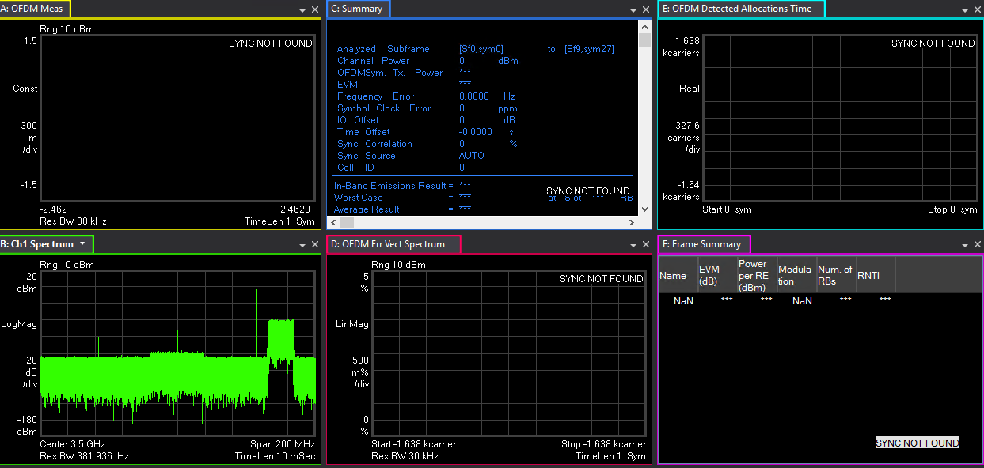
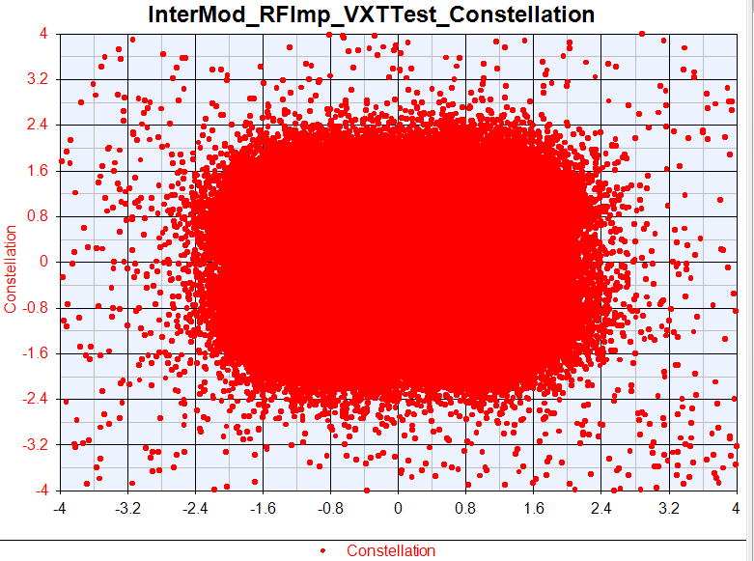
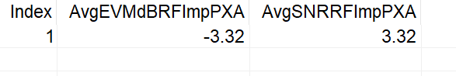
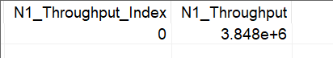
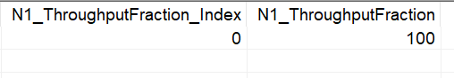
VXT Noise Figure=5

Slide 8
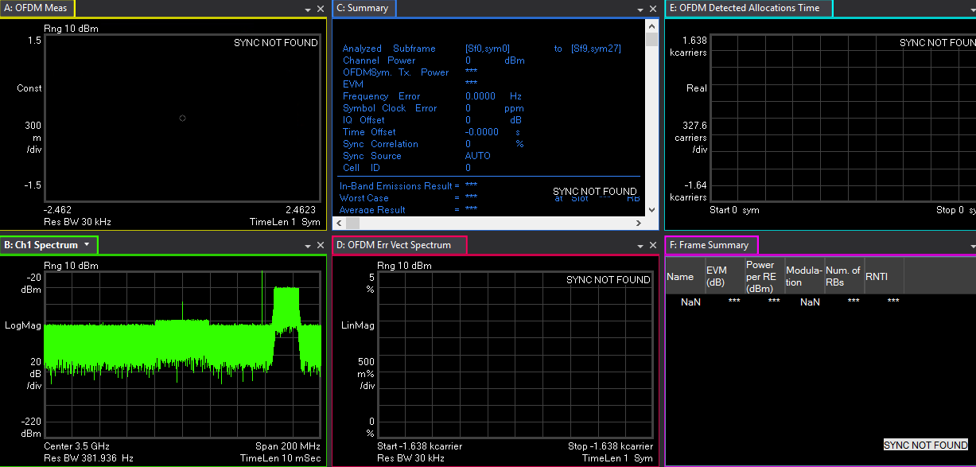
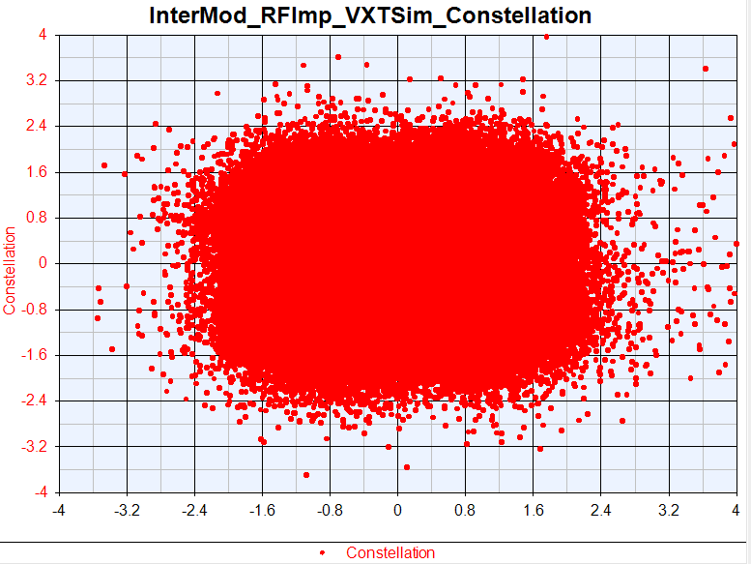
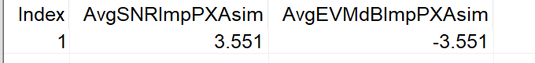
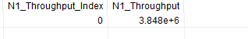
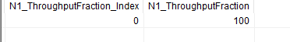
Sim Noise Figure=5

Slide 9
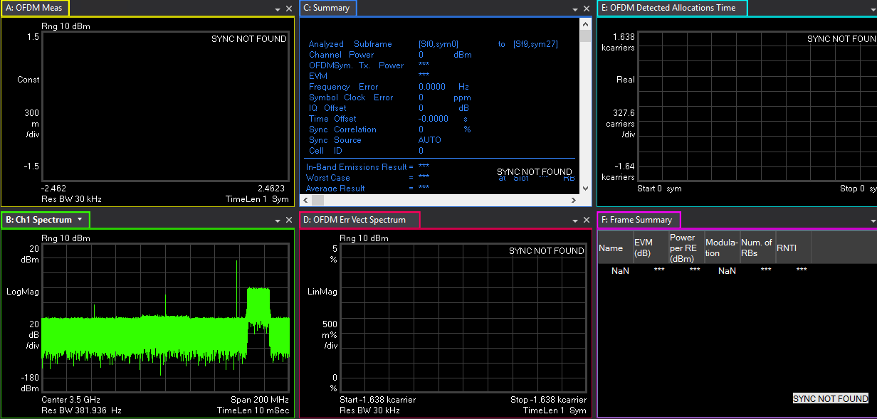
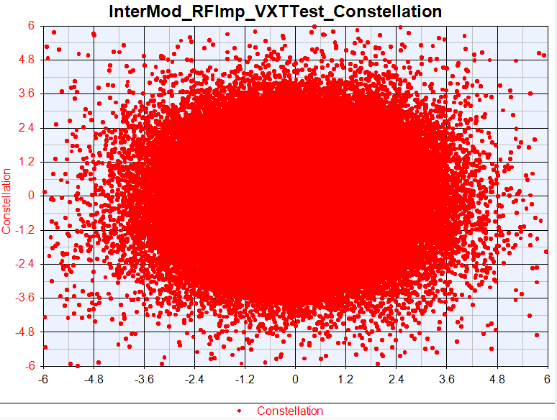
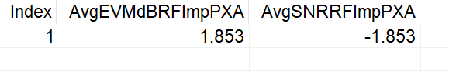
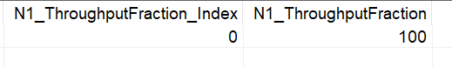
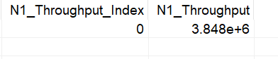
VXT Noise Figure=10

Slide 10
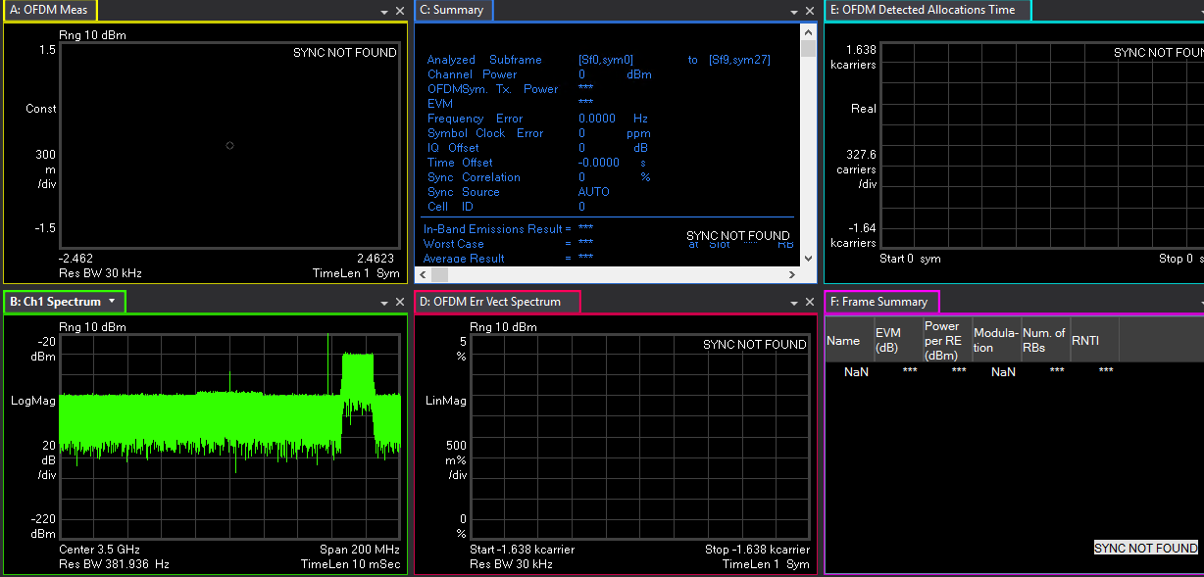
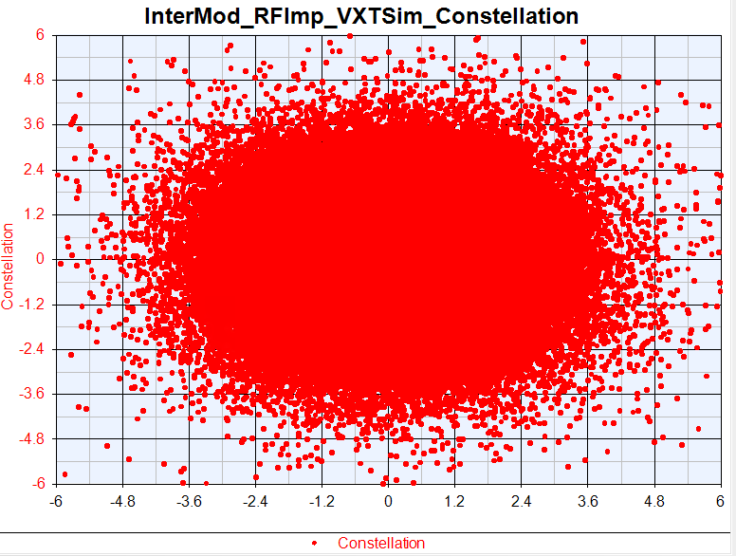
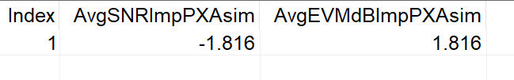
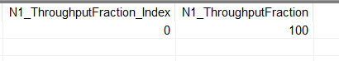
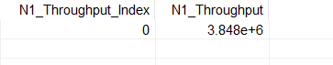
Sim Noise Figure=10

Slide 11
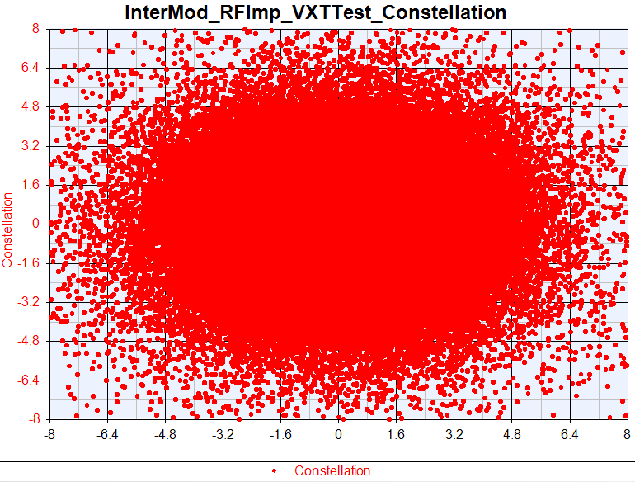
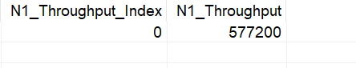
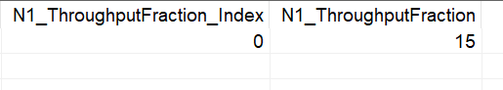
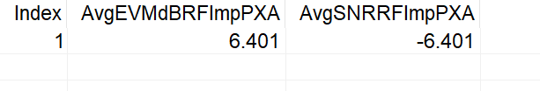
VXT Noise Figure=13

Slide 12
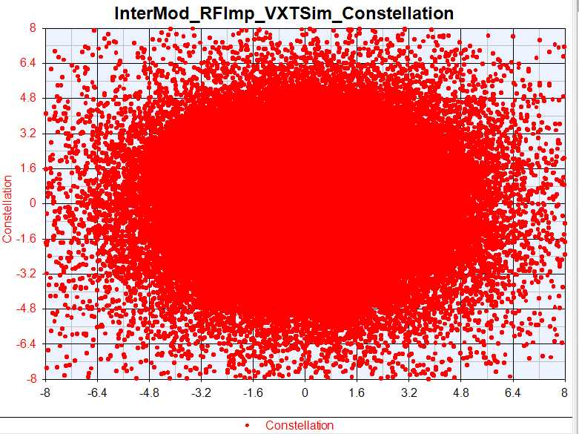
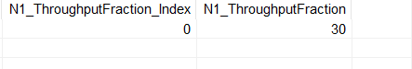
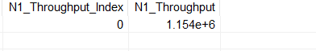
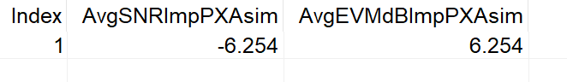
Sim Noise Figure=13

Slide 13
Phase Noise Test
ADC_NBits = 14;
LNA_NoiseFigure = 0;
RxPhaseNoise = [100, -82.133, 1000, -91.072, 1e4, 103.607];
RxGainImbalance = 0.002;
RxI_OrgOffset = 0.0006;
ADC_NBits = 14;
LNA_NoiseFigure = 0;
RxPhaseNoise =[100, -32.133, 1000, -41.072, 1e4, -53.607];
RxGainImbalance = 0.002;
RxI_OrgOffset = 0.0006;
ADC_NBits = 14;
LNA_NoiseFigure = 0;
RxPhaseNoise = [100, -87.133, 1000, -96.072, 1e4, 108.607];
RxGainImbalance = 0.002;
RxI_OrgOffset = 0.0006;

Slide 14
Phase Noise Test
Phase Noise | VXT_EVM | Sim_EVM | Delta | VXT_Throughput | Sim_Throghput
-10dB | -8.293 | -8.288 | 0.005 | 100 | 100
-15dB | -8.195 | -8.189 | 0.006 | 100 | 100
-65dB | -0.533 | -0.541 | 0.008 | 65 | 65

Slide 15
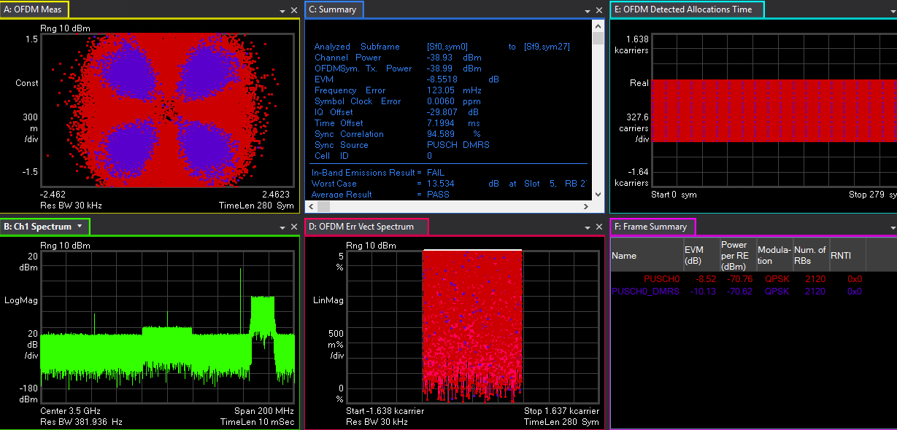
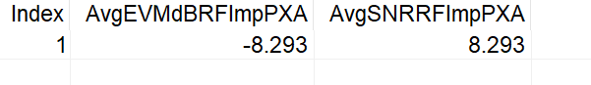
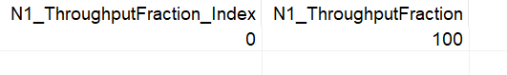
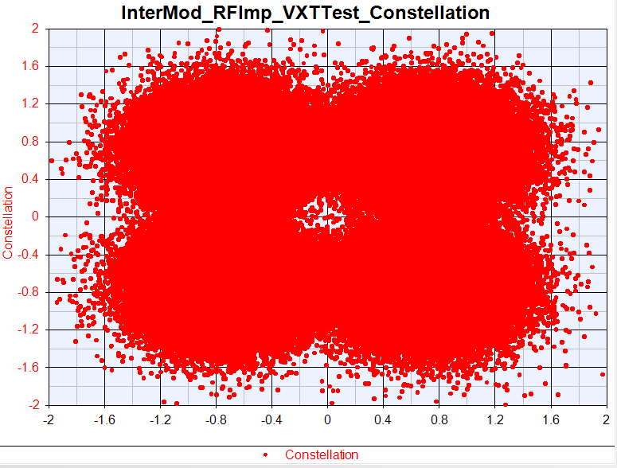
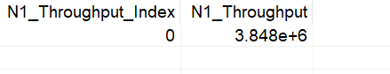
VXT Phase Noise =[100, -87.133, 1000, -96.072, 1e4, -108.607]

Slide 16
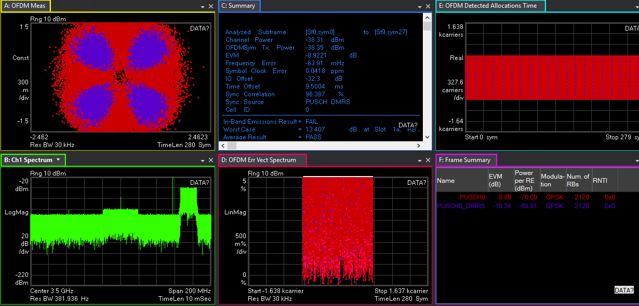
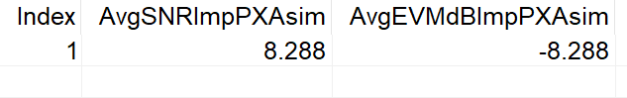
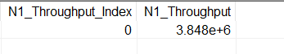
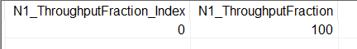
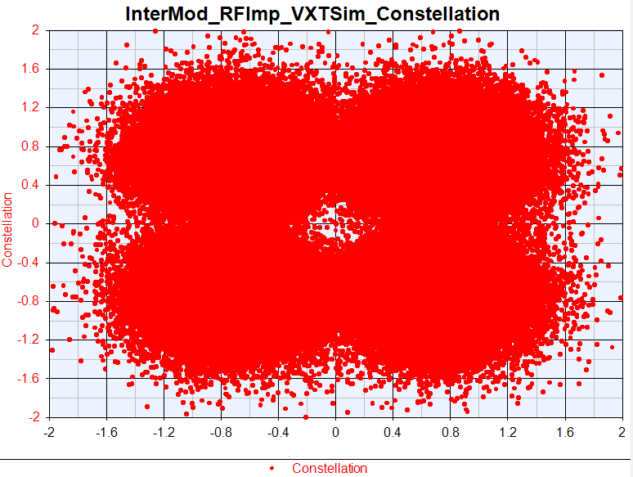
Sim Phase Noise =[100, -87.133, 1000, -96.072, 1e4, -108.607]

Slide 17
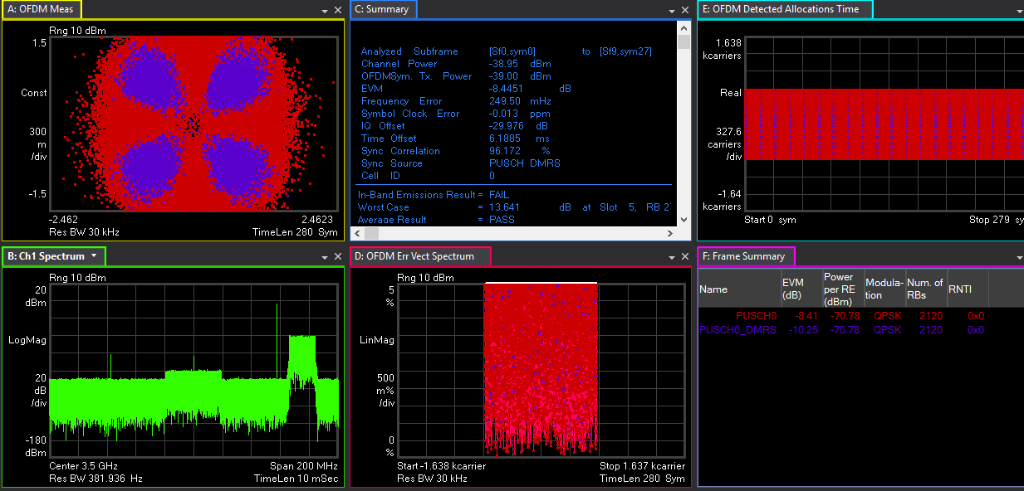
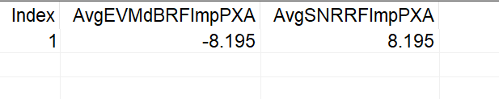



VXT Phase Noise =[100, -82.133, 1000, -91.072, 1e4, -103.607]

Slide 18





Sim Phase Noise =[100, -82.133, 1000, -91.072, 1e4, -103.607]

Slide 19





VXT Phase Noise =[100, -32.133, 1000, -41.072, 1e4, -53.607]

Slide 20





Sim Phase Noise =[100, -32.133, 1000, -41.072, 1e4, -53.607]

Slide 21
GainImbalance Test
ADC_NBits = 14;
LNA_NoiseFigure = 0;
RxPhaseNoise = [100, -97.133, 1000, -106.072, 1e4, 118.607];
RxGainImbalance = 0.02;
RxI_OrgOffset = 0.0006;
ADC_NBits = 14;
LNA_NoiseFigure = 0;
RxPhaseNoise = [100, -97.133, 1000, -106.072, 1e4, 118.607];
RxGainImbalance = 0.03;
RxI_OrgOffset = 0.0006;
ADC_NBits = 14;
LNA_NoiseFigure = 0;
RxPhaseNoise = [100, -97.133, 1000, -106.072, 1e4, 118.607];
RxGainImbalance = 16;
RxI_OrgOffset = 0.0006;

Slide 22
GainImbalance Test
Gain Imbalance | VXT_EVM | Sim_EVM | Delta | VXT_Throughput | Sim_Throghput
0.02 | -8.061 | -8.103 | 0.042 | 100 | 100
0.03 | -7.992 | -8.032 | 0.04 | 100 | 100
16 | -1.885 | -1.758 | 0.127 | 60 | 65

Slide 23





VXT GainImbalance=0.02

Slide 24





Sim GainImbalance=0.02

Slide 25





VXT GainImbalance=0.03

Slide 26





Sim GainImbalance=0.03

Slide 27





VXT GainImbalance=16

Slide 28





Sim GainImbalance=16

Slide 29
IQ offset Test
ADC_NBits = 14;
LNA_NoiseFigure = 0;
RxPhaseNoise = [100, -97.133, 1000, -106.072, 1e4, 118.607];
RxGainImbalance = 0.002;
RxI_OrgOffset = 0.002;
ADC_NBits = 14;
LNA_NoiseFigure = 0;
RxPhaseNoise = [100, -97.133, 1000, -106.072, 1e4, 118.607];
RxGainImbalance = 0.002;
RxI_OrgOffset = 0.0035;
ADC_NBits = 14;
LNA_NoiseFigure = 0;
RxPhaseNoise = [100, -97.133, 1000, -106.072, 1e4, 118.607];
RxGainImbalance = 0.002;
RxI_OrgOffset = 0.03;

Slide 30
IQ offset Test
IQ offset | VXT_EVM | Sim_EVM | Delta | VXT_Throughput | Sim_Throghput
0.002 | -5.935 | -5.342 | 0.593 | 100 | 100
0.0035 | -4.496 | -3.56 | 0.936 | 100 | 100
0.03 | 25.316 | 25.341 | 0.025 | 60 | 60

Slide 31





VXT IQ offset=0.002

Slide 32





Sim IQ offset=0.002

Slide 33





VXT IQ offset=0.0035

Slide 34





Sim IQ offset =0.0035

Slide 35




VXT IQ offset =0.03

Slide 36




Sim IQ offset=0.03

Slide 37
ADC_Nbits Test
ADC_NBits = 14;
LNA_NoiseFigure = 0;
RxPhaseNoise = [100, -97.133, 1000, -106.072, 1e4, 118.607];
RxGainImbalance = 0.002;
RxI_OrgOffset = 0.0006;
ADC_NBits = 12;
LNA_NoiseFigure = 0;
RxPhaseNoise = [100, -97.133, 1000, -106.072, 1e4, 118.607];
RxGainImbalance = 0.002;
RxI_OrgOffset = 0.0006;
ADC_NBits = 10;
LNA_NoiseFigure = 0;
RxPhaseNoise = [100, -97.133, 1000, -106.072, 1e4, 118.607];
RxGainImbalance = 0.002;
RxI_OrgOffset = 0.0006;

Slide 38
ADC_Nbits Test
ADC_Nbits | VXT_EVM | Sim_EVM | Delta | VXT_Throughput | Sim_Throghput
14 | -8.379 | -8.383 | 0.004 | 100 | 100
12 | -8.084 | -8.046 | 0.038 | 100 | 100
10 | -7.555 | -7.757 | 0.202 | 100 | 100

Slide 39
VXT ADC_Nbits=14

Slide 40
Sim ADC_Nbits=14

Slide 41





VXT ADC_Nbits=12

Slide 42





Sim ADC_Nbits=12

Slide 43





VXT ADC_Nbits=10

Slide 44





Sim ADC_Nbits=10

Slide 45
Combine Test
Origin Para:
ADC_NBits = 14;
LNA_NoiseFigure = 0;
RxPhaseNoise = [100, -97.133, 1000, -106.072, 1e4, -118.607];
RxGainImbalance = 0.002;
RxI_OrgOffset = 0.0006;
Change 5dB:
ADC_NBits = 12;
LNA_NoiseFigure = 5;
RxPhaseNoise = [100, -92.133, 1000, -101.072, 1e4, -113.607];
RxGainImbalance = 0.01;
RxI_OrgOffset = 0.0011;
Change 10dB:
ADC_NBits = 10;
LNA_NoiseFigure = 10;
RxPhaseNoise = [100, -87.133, 1000, -96.072, 1e4, 108.607];
RxGainImbalance = 0.02;
RxI_OrgOffset = 0.002;

Slide 46
Combine Test
Combine Test | VXT_EVM | Sim_EVM | Delta | VXT_Throughput | Sim_Throghput
Origin Para | -8.379 | -8.383 | 0.004 | 100 | 100
Change 5dB | -3.104 | -2.9 | 0.204 | 100 | 100
Change 10dB | 1.972 | 2.402 | 0.43 | 100 | 100

Slide 47
VXT Combine Test Origin Para

Slide 48
Sim Combine Test Origin Para

Slide 49





VXT Combine Test Change 5dB

Slide 50





Sim Combine Test Change 5dB

Slide 51





VXT Combine Test Change 10dB

Slide 52





Sim Combine Test Change 10dB

Slide 53
OTA Test Para
仪表参数：
Power out=15dBm
Density=-156.3
IQoffset=0.00002
Gain Imb=0.002
PhaseNoise=[100 -98.57 1e3 -107.56 1e4 -121.67]
ADC_Nbits=14
Imp 测试参数：
Power out=15dBm
Density=-156.3
IQoffset=0.02
Gain Imb=0.02
PhaseNoise=[100 -88.57 1e3 -97.56 1e4 -111.67]
ADC_Nbits=12
NoiseFigure=5
Length=1.1m
Pathloss=-46dBm

Slide 54
Intermodulation OTA Test
Intermodulation | Test_EVM(dB) | Sim_EVM(dB) | Delta(dB) | Test_Throughput(%) | Sim_Throughput(%)
Ideal | -7.911 | -7.961 | 0.05 | 100 | 100
RFImp | -2.264 | -2.133 | 0.131 | 100 | 100

Slide 55





Ideal Intermodulation OTA Test

Slide 56





Sim OTA Ideal Intermodulation
Density=156.3
IQ offset=0.00002

Slide 57





OTA RFImp Intermodulation Test

Slide 58





Sim OTA RFImp Intermodulation

